Slide 1
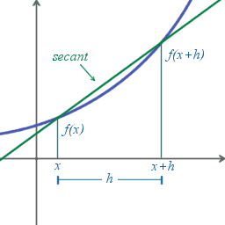
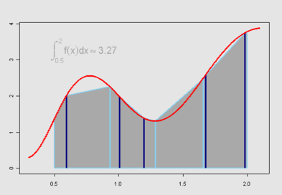
Numerical Differentiation and Integration (3)

Slide 2
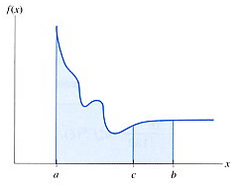
Adaptive Integration
Adaptively adjust interval size based on function behavior or specified accuracy
smaller h
larger h

Slide 3
Adaptive Scheme
Iteratively subdivide the interval until the specified accuracy is achieved
Comparing the magnitude of difference in previous and current iterations
Apply Richardson extrapolation to further improve accuracy; for an n-th order accurate algorithm

Slide 4
Example: Adaptive Integration
http://www.cs.illinois.edu/~heath/iem/integration/adaptivq/

Slide 5
Gaussian Quadrature
Also based on polynomial interpolation, but nodes and weights are chosen to maximize the degree of the resulting rule (or interpolant)
x-values are not predetermined
For an n-term rule,
there are 2n parameters → polynomial of degree 2n-1 can be obtained
Only n function evaluations need be computed!
Node and weight parameters are determined using method of undetermined coefficients

Slide 6
Example: Two term Gaussian quadrature
Approximate the integral by
Apply method of undetermined coefficients
Notes:
See pp 302 of the text for solving details.

Slide 7
Change of interval
If the integral interval is [a, b], we can transform it to [-1, 1]

Slide 8
Example:

Slide 9
Gaussian Quadrature: n-term rule
Generalization to n-term rule
Determine parameters by solving a set of 2n nonlinear equations

Slide 10
Legendre Polynomial
Roots of the n-th degree Legendre polynomial:
are the roots for

Slide 11
Computing weights in Gaussian Quadrature
Roots of Legendre polynomial can be obtained by root finding algorithms in Chap 1
Replacing t_{i}’s by the roots, the set of equations for computing parameters becomes a system of linear equations of w_{i}’s; solving it for weights

Slide 12
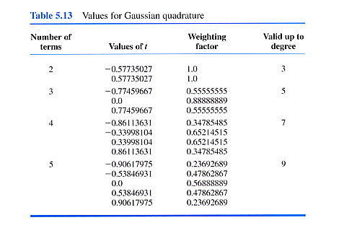
Values for Gaussian Quadrature

Slide 13
Example: compute 4-term formula of
Change to variable t for limits [-1 1]
Using Table 5.13
t₁
w₁
t₂
w₂
t₃
w₃
t₄
w₄

Slide 14
Multiple Integrals
Extend Newton-Cotes quadrature formula to multi-dimensions
Integrate on multiple dimensions one by one
hold all the other dimensions constant while integrate with respect to a dimension
For example,

Slide 15
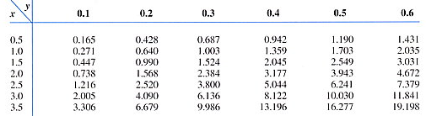
Example: Double Integral
Evaluate integral
Use trapezoidal rule in the x-direction

Slide 16
Example (cont.)
Evaluate integral
Use trapezoidal rule in the x-direction

Slide 17
Example (cont.)
Evaluate integral
Similarly,
Apply Simpson’s 1/3 rule in the y-direction

Slide 18
Multiple Integrals—General Form
Approximate function by polynomial of multiple variables up to degree s (=α+β+γ)
Generalization to n-dimensional integral is easy → n summations

Slide 19
Example: Multiple Integrals
Example 5.14
Changes of variables for limits [-1, 1]

Slide 20
Example: Multiple Integrals (cont.)
Use 3-term Gaussian formula for x
Use 2-term Gaussian formula for u and v
The integral becomes

Slide 21
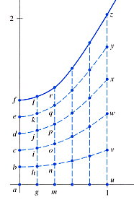
Example: Integrating with Variable Limits
Trapezoidal rule on y
Trapezoidal rule on x
…

Slide 22
Example: Integrating with Variable Limits
Change of variables for limits

Slide 23
Example: Integrating with Variable Limits
Use Gaussian quadrature
Table 5.13
s₁
w₁
s₂
w₂
s₃
w₃
t₁
W₁
t₂
W₂
t₃
W₃
t₄
W₄

Slide 24
Error in Multiple Integration
Similar fashion as we did for single integration
See pp 315-316 of the textbook for an example of the error of a double integral

Slide 25
Monte Carlo Method
A generally viable approach in high dimensions
Can handle integral over an irregular-shape domain
Function is sampled at n points distributed randomly in the domain of integration, and mean function values are multiplied by the area (or volume, etc.) of domain to obtain estimate for integral
Often require millions of function evaluations

Slide 26
Example: Monte Carlo Method
1-D Monte Carlo
http://heath.cs.illinois.edu/iem/integration/mntcurve/
2-D Monte Carlo
http://heath.cs.illinois.edu/iem/integration/mntcirc/

Slide 27
When should I use Monte Carlo?
Monte Carlo method is not competitive for the number of dimensions one or two, but the beauty of the method is that its convergence rate is independent of the number of dimensions
For example, one million points in six dimensions amount to only ten points per dimension, which is much better than any conventional quadrature rule would require for the same level of accuracy

Slide 28
Summary
How are numerical differentiation and integration computed?
Approximated by combination of function values
Original function is approximated as polynomial interpolant (their coeffs. are not explicitly determined)
Solving for w_{i} (and x_{i})

